Slide 2
1. Convert .d to mzml using MSConvert
2. Run “setup_environment.py” (only run once, no need to run more than once)
3. Open “main.py” – scroll to bottom
4. Give output path in “main.py” for csv output
5. Run “main.py”
6. Select mzml file to be analyzed in the popup
7. Go to the output location – csv output should be there

Slide 3
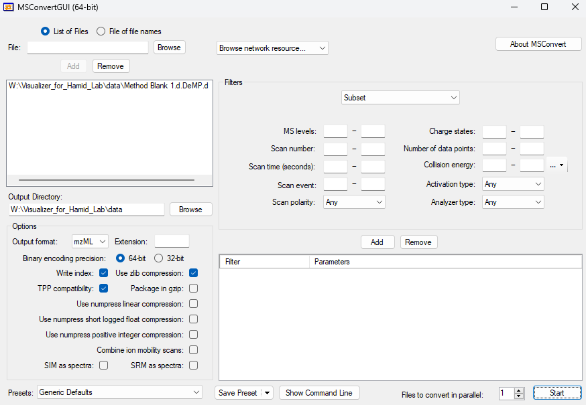
Using MSConvert
Convert .d into mzML
No filters are selected, just load in the data and hit start
https://proteowizard.sourceforge.io/download.html

Slide 4
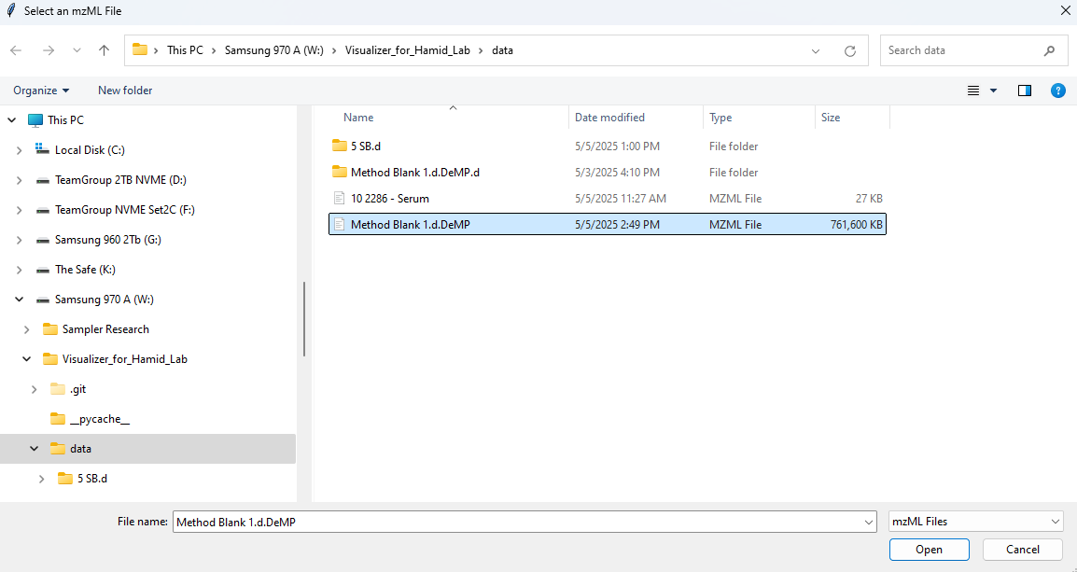
Pop up from the Main.py
Read in the mzml file into the script

Slide 5
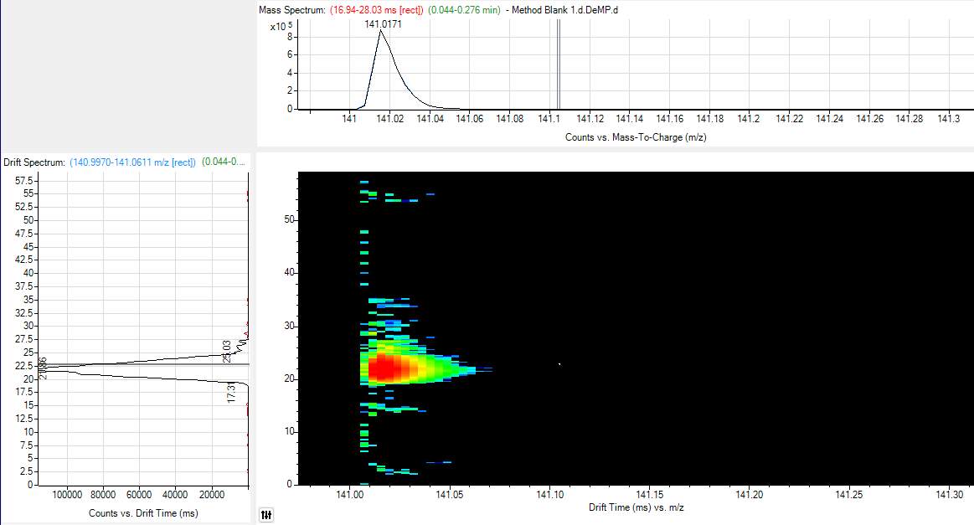
Browser feature
CSV export
m/z | Retention Time (sec) | Drift Time (ms) | Intensity | Count
141.0159609 | 8.016101299 | 23.06790938 | 887799 | 770
Number of points within the peak
Openms is able to extract features accurately – I then am implementing a clustering algorithm (DBSCAN) in which I am using some basic instrument parameters to determine clusters (the count in the csv). This is then able to be plotted into some very nice 3D plots.
I have applied a feature intensity threshold as I am using experimental samples and there is a lot of background.

Slide 6
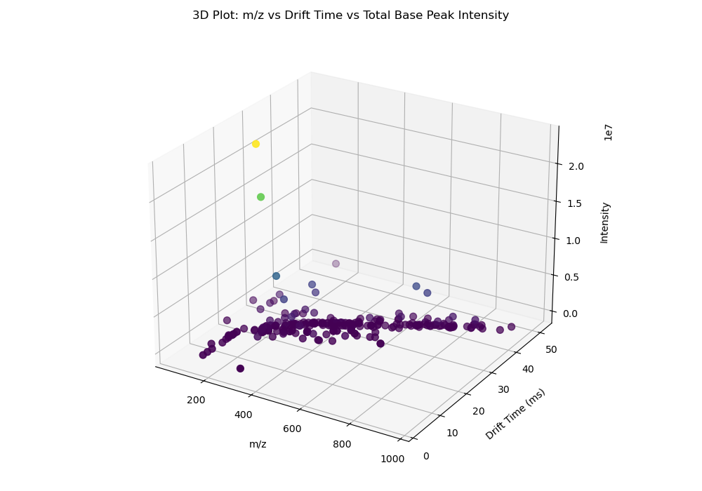

Slide 7
